Slide 1
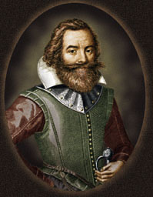
facebook
Wall
Photos
John Smith
Logout
John Smith
Wall
Info
Photos
Information
Current City: Jamestown
Hometown: Willoughby, England
Sex: Male
Birthday: January 9, 1579
Relationship Status: Single
Spouse:
Employer: Virginia Company
Education: Self-Educated
Religion: Church of England
Political Views: Follow our King and Prince
People Who Inspire: Pocahontas for being hardworking and brave
Favorite Quotations: “He who does not work, will not eat."
Favorite Books: A True Relation of Such Occurrences and Accidents of
Note as Hath Happened in Virginia and A Description of
New England in 1616
Activities: Sailing, deer hunting, gold mining
Wall
Info
Photos
Friends
Contact Information
Address: 1367 Colonial Parkway, Jamestown , VA 23081

Slide 2
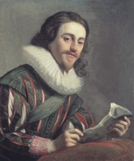
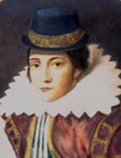
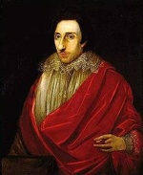
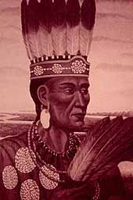
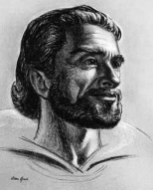
facebook
Wall
Photos
John Smith
Logout
John Smith
Wall
Info
Photos
Update status-January 1615
Coming home to England!
Share
Wall
Info
John Smith heading back to the New World to an area north of Jamestown. Will name the new area I’m visiting New England if my prince approves.
March 1614 Like · Comment · See Friendship
Photos
Friends
Prince Charles I approve your name choice.
Friends
John Smith returning to England to get help with my gunpowder wound.
Oct. 1609 Like · Comment · See Friendship
Pocahontas
George Percy Happy to see you go, so I can be President of the colony!
Powhatan
John Smith had an accident with gunpowder today.
Oct. 1609 Like · Comment · See Friendship
Captain Christopher Newport
John Smith is so hungry today! This winter will be known as the Starving Time.
Dec. 1608 Like · Comment · See Friendship

Slide 3
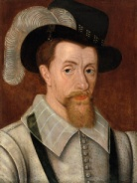
facebook
Wall
Photos
John Smith
Logout
John Smith
John Smith is so honored to be elected the president of our local Jamestown council.
Sept. 1608 Like · Comment · See Friendship
Friends
John Smith So glad to be back in Jamestown. Thank you Pocahontas for saving my life!
Jan. 1608 Like · Comment · See Friendship
George Percy
Pocahontas Glad this eleven year old girl could help!
Powhatan You are so lucky I trust my daughter. Otherwise, you would be dead.
King James I
Prince Charles
John Smith has been ambushed by hostile Indians! Stay out of the woods today!
Dec. 1607 Like · Comment · See Friendship
John Smith landed at Jamestown today. Hope these guys are ready to work!
May 13, 1607 Like · Comment · See Friendship

Slide 4
facebook
Wall
Photos
John Smith
Logout
John Smith
John Smith reached New World today and found out I am one of the seven council members chosen to govern the colony.
April 1607 Like · Comment · See Friendship
George Percy Why I wasn’t chosen is beyond me! After all, I have the highest social ranking of all the colonists.
Captain Chris Newport to John Smith Are you as excited as I am to be sailing for the New World? I can’t wait to command three ships: the Susan Constant, Godspeed, and Discovery.
Dec. 20, 1606 Like · Comment · See Friendship
John Smith joined the Virginia Company. We will be rich beyond our dreams when we find silver and gold in the New World.
June 1606 Like · Comment · See Friendship
King James Happy to grant your group a charter, but remember to bring the riches back home to England.

Slide 5
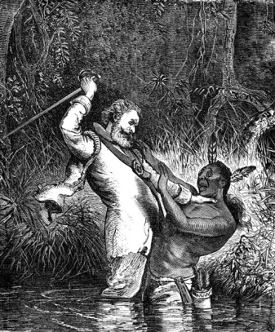
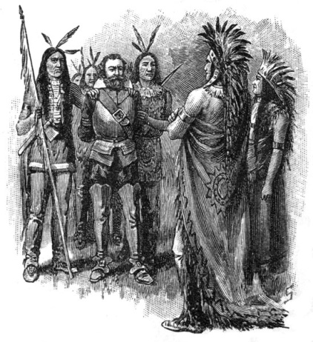
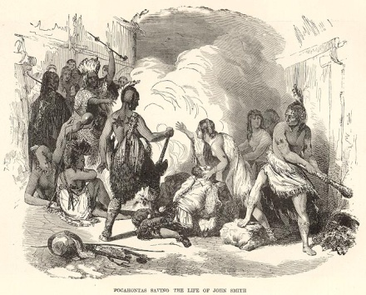
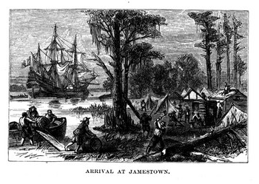
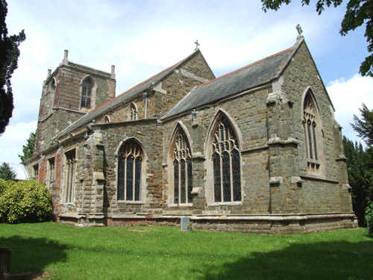
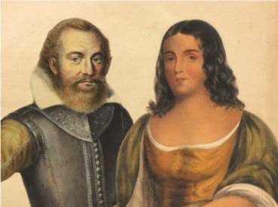
facebook
Wall
Photos
John Smith
Logout
John Smith
Wall
Info
Photos
Photos of John 6 Photos

