Slide 1
Out in the estuary a tight woven school of small fishes glittered and broke water to escape a school of great fishes that drove in to eat them. And in the houses the people could hear the swish of the small ones and the bouncing splash of the great ones as the slaughter went on. The dampness arose out of the Gulf and was deposited on bushes and cacti and on little trees in salty drops. And the night mice crept about on the ground and the little night hawks hunted them silently.

Slide 2
“The Hunting of the Man”
The Island of Doctor Moreau
H.G. Wells (1866–1946)
“Then suddenly I heard a staghound bay, and at that realized a new danger. I took little time to think, or they would have caught me then, but snatching up my nailed stick, rushed headlong from my hiding-place towards the sound of the sea. I remember a growth of thorny plants, with spines that stabbed like pen-knives. I emerged bleeding and with torn clothes upon the lip of a long creek opening northward. I went straight into the water without a minute’s hesitation, wading up the creek, and presently finding myself knee-deep in a little stream. I scrambled out at last on the westward bank, and with my heart beating loudly in my ears, crept into a tangle of ferns to await the issue. I heard the dog (there was only one) draw nearer, and yelp when it came to the thorns. Then I heard no more, and presently began to think I had escaped.”
Back to Home

Slide 3
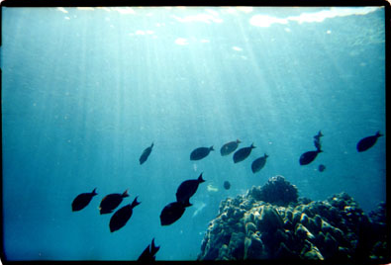
Back to Home

Slide 4
From Chapter 6 of The Pearl
“Come,” he said. “We will go into the mountains. Maybe we can lose them in the mountains.” And Kino ran for the high places, as nearly all animals do when they are pursued.
Back to Home

